Slide 1
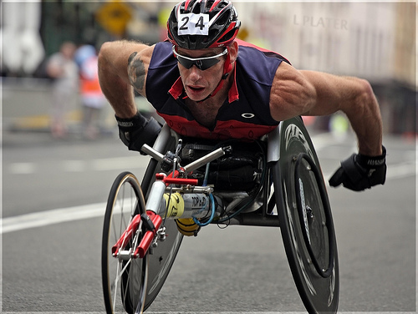
Ultrasound imaging of acute biceps tendon changes after wheelchair sports
Joel Sandé

Slide 2
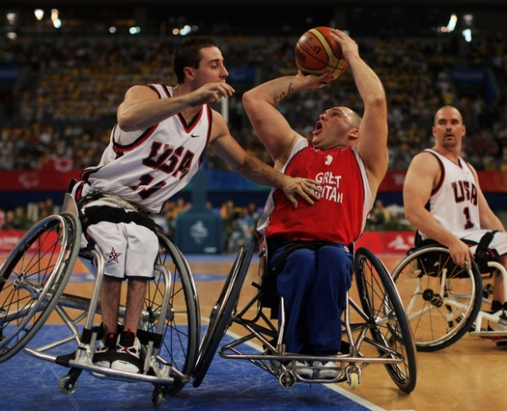
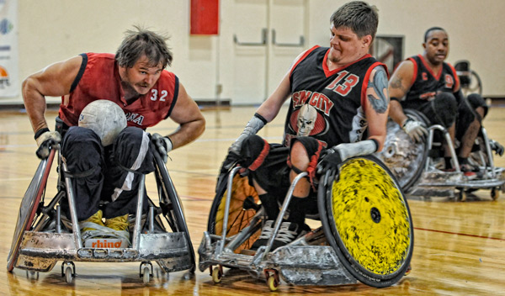
Objectives: To investigate acute changes in the biceps tendon after a high-intensity wheelchair propulsion activity and to determine whether these changes are related to body mass.
Method: The biceps tendon was imaged with ultrasound before and after wheelchair basketball or quad rugby.
Participants: 42 subjects who participated in wheelchair basketball or quad rugby - aged 18 – 65 yrs.
Main Outcome Measures:
Biceps tendon diameter
Biceps echogenicity

Slide 3
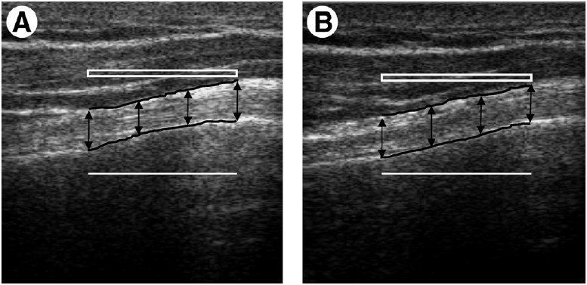
Introduction
Pregame & Postgame image of Biceps tendon
When using ultrasound to diagnose shoulder pathology, structures containing more fluid appear darker : less echogenic (ability to return a signal) hypothesized that because of increased edema, the biceps tendon would become less echogenic and
increase in size after participation in an intense physical activity – higher changes in subjects with larger body mass.
The echogenicity of the tendon was determined by calculating the average pixel intensity value (0 - black and 255 - white) throughout the selected area.

Slide 4
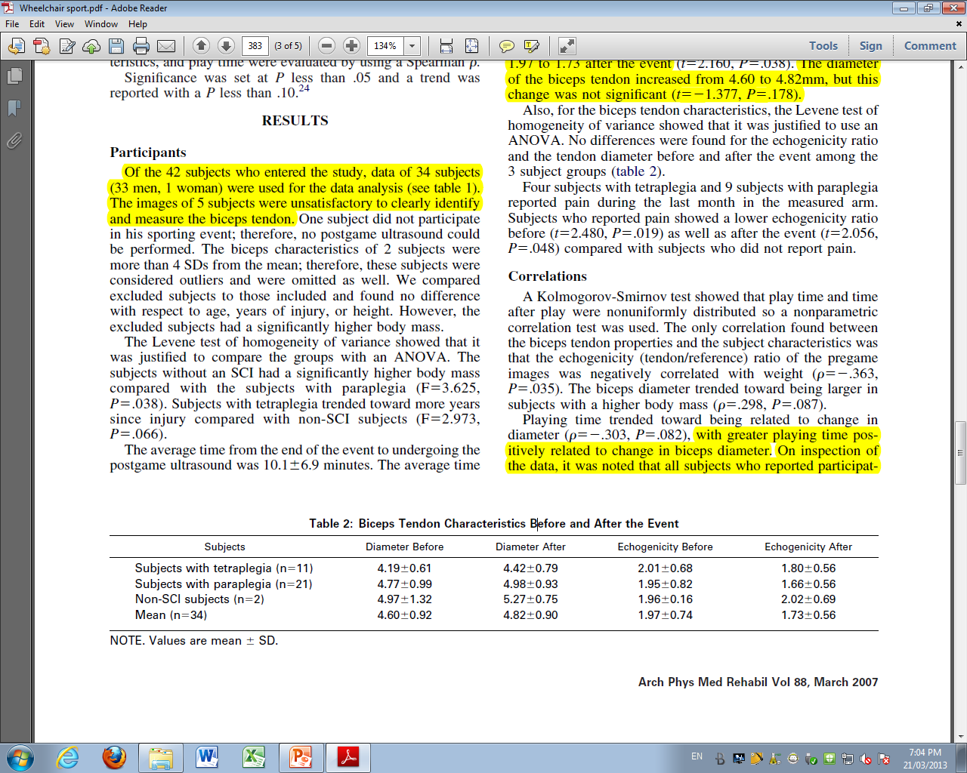
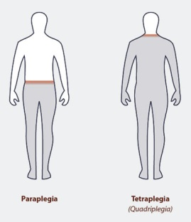
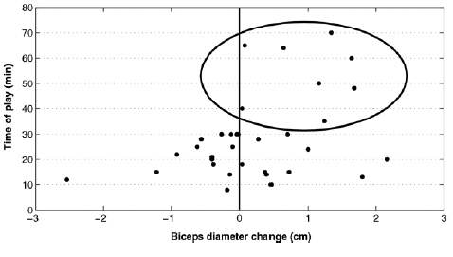
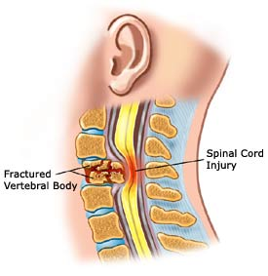
Results
(P =.178)
(P =.038)
(P =.004)

Slide 5
Results
Echogenicity (tendon/reference) ratio of the pregame images was negatively correlated with weight (P =.035).
The biceps, diameter trended toward being larger in subjects with a higher body mass (P=.087).
Note:
In the acute phase of tendon pathology, increased fluid content leads to swelling of the tendon.
Specific joint forces and moments during wheelchair propulsion are directly related to shoulder pathology.

Slide 6
Conclusions
Acute changes in biceps tendon properties after exercise.
This likely represent edema, a first sign of overuse injury.
The significance of continuous activity was shown by the fact that subjects who had more playing time showed a larger increase in tendon diameter.

Slide 7

Reference
Stefan van Drongelen, PhD, Michael L. Boninger, MD, Bradley G. Impink, Tagreed Khalaf, MD. Ultrasound Imaging of Acute Biceps Tendon Changes After Wheelchair Sports. (March 2007) Arch Phys Med Rehabil Vol 88.

